Slide 1
Introduction of Object Oriented Programming Using Java 2
Lecture 1

Slide 2
Java
From C, Java derives its syntax from C and from C++ it derives all the object oriented features.

Slide 3
History of Java
C-1972 -Dennis Ritchie standardized on 1989 by ANSI
C++-1979 -Bjarne stroustrup
Java(Initially called as Oak)
  Conceived by James gosling ,Patrick Naughton,Chris Warth,Ed frank and mike sheridon in 1991.(took 18 months to develop first working version)
  Then The team bill joy, Arthur,Tim and frank are key contributors later.

Slide 4
Features of Java
Simple
Object-Oriented
Platform independent
Secured
Robust
Architecture neutral
Portable
Dynamic
Interpreted
High Performance
Multithreaded
Distributed

Slide 5
Simple
Java is a simple . Because java has the more library function than c/c++
Object Oriented
Basic concepts of OOPs are:
  Object
  Class
  Inheritance
  Polymorphism
  Abstraction
  Encapsulation

Slide 6
Platform Independent
Code runs like the same irrespective of the platform involved.
Java has JVM(Java virtual Machine) for all platforms(SUN , IBM, Microsoft).
Source code is written in high level language and converted to byte code(for Java Runtime Environment) not read by original platform but by JVM can read it.
That is Write once Run Anywhere.
JVM has In time compilation done if required using Java intime compiler(JIT)
compiler for creating .class file.
JVM –java virtual machine for interpreting java program
Steps:
Source code
Java compiler (gives byte code (.class file))
JVM gives executable code(.obj)

Slide 7
Secured
Java is secured because:
No explicit pointer
Programs run inside virtual machine sandbox.
Robust
Robust simply means strong.
Java uses strong memory management.
There are lack of pointers that avoids security problem.
There is automatic garbage collection in java.
There is exception handling and type checking mechanism in java.

Slide 8
Architecture-neutral and Portable
There is no implementation dependent features
We may carry the java byte code to any platform.
High-performance
Since byte code closer to native code.
Takes of benefit of compilation and Interpretation.

Slide 9
Distributed
We can create distributed applications in java.
RMI and EJB are used for creating distributed applications.
We may access files by calling the methods from any machine on the internet.
Multi-threaded
A thread is like a separate program, executing concurrently.
We can write Java programs that deal with many tasks at once by defining multiple threads.
The main advantage of multi-threading is that it shares the same memory.
Threads are important for multi-media, Web applications etc.

Slide 10
Programming Languages
Programming languages allow programmers to code software.
The three major families of languages are:
  Machine languages
  Assembly languages
  High-Level languages

Slide 11
Machine Languages
Comprised of 1s and 0s
The “native” language of a computer
Difficult to program – one misplaced 1 or 0 will cause the program to fail.
Example of code:
1110100010101 111010101110
10111010110100 10100011110111

Slide 12
Assembly Languages
Assembly languages are a step towards easier programming.
Assembly languages are comprised of a set of elemental commands which are tied to a specific processor.
Assembly language code needs to be translated to machine language before the computer processes it.
Example:
ADD A,B

Slide 13
High-Level Languages
High-level languages represent a giant leap towards easier programming.
The syntax of HL languages is similar to English.
Historically, we divide HL languages into two groups:
  Procedural languages
  Object-Oriented languages (OOP)

Slide 14
Procedural Languages
Early high-level languages are typically called procedural languages.
Procedural languages are characterized by sequential sets of linear commands. The focus of such languages is on structure.
Examples include C, COBOL, Fortran, LISP, Perl, HTML, VBScript

Slide 15
Object-Oriented Languages
Most object-oriented languages are high-level languages.
The focus of OOP languages is not on structure, but on modeling data.
Programmers code using “blueprints” of data models called classes.
Examples of OOP languages include C++, Visual Basic.NET and Java.

Slide 16
Object Oriented Programming
Object – Unique programming entity that has methods, has attributes and can react to events.
Method – Things which an object can do; the “verbs” of objects. In code, usually can be identified by an “action” word.

Slide 17
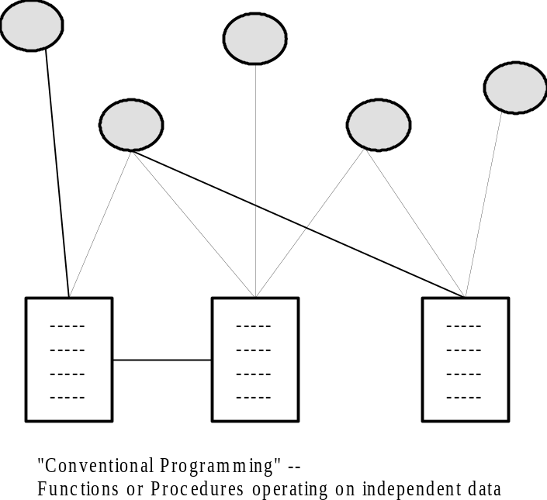
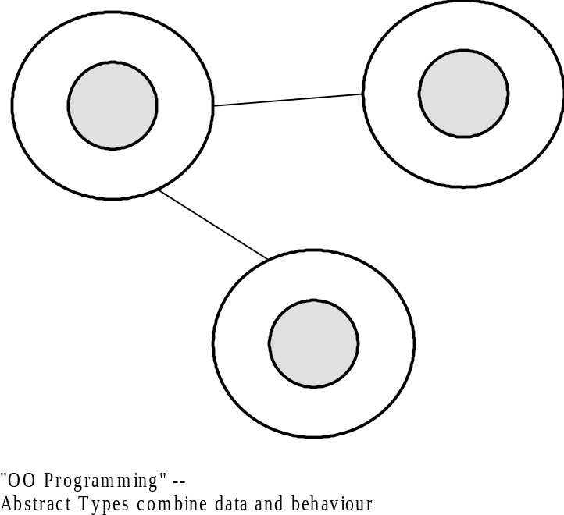
Notes:
Note that there’s no relationship between data and functions. Data may be reused in several places, so each function has to have knowledge of that data, e.g. what types it contains, where its stored, etc, etc.
In an OO model each object maintains its own data. The functions and data are “fused” into an abstract data type.
Note that this is more manageable as I can change the structure of any piece of data, e.g. integer to floating point, add/remove new pieces of information without impacting any of the rest of the application. It’s what helps make OO systems more reusable.

Slide 18
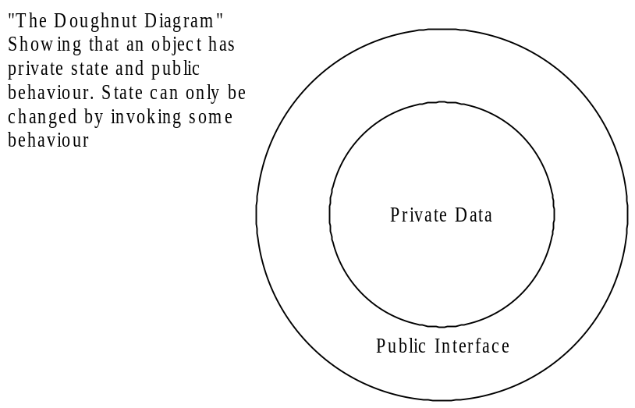
OOP - Encapsulation
Incorporation into a class of data & operations in one package
Data can only be accessed through that package
“Information Hiding”

Slide 19
OOP - Inheritance
Allows programmers to create new classes based on an existing class
Methods and attributes from the parent class are inherited by the newly-created class
New methods and attributes can be created in the new class, but don’t affect the parent class’s definition

Slide 20
OOP - Polymorphism
Polymorphic methods can adapt to specific types of objects.

Slide 21
Classes and Objects
A class is a data type that allows programmers to create objects. A class provides a definition for an object, describing an object’s attributes (data) and methods (operations).
An object is an instance of a class. With one class, you can have as many objects as required.
This is analogous to a variable and a data type, the class is the data type and the object is the variable.
Notes:
Write a program is the same as solving other problems – the steps are the same, only the product is different.

Slide 22
Java Basics
Seperators () [] {} ; , .
Comments
Literals/constants
Data types(strongly typed language)
  Integers
  Floating point
  Character (escape sequences)
  String
  Boolean
Notes:
Write a program is the same as solving other problems – the steps are the same, only the product is different.

Slide 23
Data types
Data Type | Characteristics | Range
byte | 8 bit signed integer | -128 to 127
short | 16 bit signed integer | -32768 to 32767
int | 32 bit signed integer | -2,147,483,648 to 2,147,483,647
long | 64 bit signed integer | -9,223,372,036,854,775,808 to- 9,223,372,036,854,775,807
float | 32 bit floating point number | + 1.4E-45 to + 3.4028235E+38
double | 64 bit floating point number | + 4.9E-324 to + 1.7976931348623157E+308
boolean | true or false | NA, note Java booleans cannot be converted to or from other types
char | 16 bit, Unicode | Unicode character, \u0000 to \uFFFF Can mix with integer types
Notes:
Write a program is the same as solving other problems – the steps are the same, only the product is different.

Slide 24
Variables
Type & Identifier name.
Variables- declaration, Initialization, scope and lifetime of a variable
  Same name variables in outer and inner scope is error.
Notes:
Write a program is the same as solving other problems – the steps are the same, only the product is different.

Slide 25
Type Casting

Slide 26
l
i
int
32 bit
long
64 bit
Casting

Slide 27
Moving Between Buckets
"Casting"
i = (int)l;
Narrowing
l = (long)i;
l = i;
Widening
l
l
long l;
int i;
i
i
long
64 bit
int
32 bit
long
64 bit
int
32 bit

Slide 28
The Primitive Numbers
Declaration Size and Type Number Range
byte b; // 8 bit integer -2⁻⁷ to +2⁺⁷-1
short s; // 16 bit integer -2⁻¹⁵ to +2⁺¹⁵-1
char c; // 16 bit Unicode 0 to +2⁺¹⁶
int i; // 32 bit integer -2⁻³¹ to +2⁺³¹-1
long l; // 64 bit integer -2⁻⁶³ to +2⁺⁶³-1
float f; // 32 bit floating point IEEE754 Standard
double d; // 64 bit floating point IEEE754 Standard

Slide 29
Acceptable Implicit Casts
char
16 bit
byte
8 bit
short
16 bit
int
32 bit
long
64 bit
float
32 bit
double
64 bit
Illegal
b = l;
l = f;
c = s;
f = l
OK
l = b;
i = c;

Slide 30
Arithmetic Promotion with Mixed Primitives
char
16 bit
byte
8 bit
short
16 bit
int
32 bit
long
64 bit
float
32 bit
double
64 bit
Illegal Casts
i = i + l;
f = f + d;
l = l + f;
OK
i = (int)(i + l);
d = (double)(f + d);
l = (long)(l + f);

Slide 31
Using Java Operators

Slide 32
Assignment Operator (=)
lvalue = rvalue;
w = 10;
x = w;
z = (x - 2)/(2 + 2);
Take the value of the rvalue and store it in the lvalue.
The rvalue is any constant, variable or expression.
The lvalue is named variable.

Slide 33
Mathematical Operators
Addition +
Subtraction -
Multiplication *
Division /
Modulus %

Slide 34
Simple Arithmetic
public class Example {
public static void main(String[] args) {
int j, k, p, q, r, s, t;
j = 5;
k = 2;
p = j + k;
q = j - k;
r = j * k;
s = j / k;
t = j % k;
System.out.println("p = " + p);
System.out.println("q = " + q);
System.out.println("r = " + r);
System.out.println("s = " + s);
System.out.println("t = " + t);
}
}
output
p = 7
q = 3
r = 10
s = 2
t = 1

Slide 35
Shorthand Operators
+=, -=, *=, /=, %=
Common Shorthand
a = a + b; a += b;
a = a - b; a -= b;
a = a * b; a *= b;
a = a / b; a /= b;
a = a % b; a %= b;

Slide 36
Shorthand Operators
public class Example {
public static void main(String[] args) {
int j, p, q, r, s, t;
j = 5;
p = 1; q = 2; r = 3; s = 4; t = 5;
p += j;
q -= j;
r *= j;
s /= j;
t %= j;
System.out.println("p = " + p);
System.out.println("q = " + q);
System.out.println("r = " + r);
System.out.println("s = " + s);
System.out.println("t = " + t);
}
}
p = 6
q = -3
r = 15
s = 0
t = 0

Slide 37
Shorthand Increment and Decrement ++ and --
Common Shorthand
a = a + 1; a++; or ++a;
a = a - 1; a--; or --a;

Slide 38
Increment and Decrement
public class Example {
public static void main(String[] args) {
int j, p, q, r, s;
j = 5;
p = ++j; // j = j + 1; p = j;
System.out.println("p = " + p);
q = j++; // q = j; j = j + 1;
System.out.println("q = " + q);
System.out.println("j = " + j);
r = --j; // j = j -1; r = j;
System.out.println("r = " + r);
s = j--; // s = j; j = j - 1;
System.out.println("s = " + s);
}
}
p = 6
q = 6
j = 7
r = 6
s = 6

Slide 39
Relational Operators
> < >= <= == !=
Primitives
Greater Than >
Less Than <
Greater Than or Equal >=
Less Than or Equal <=
Primitives or Object References
Equal (Equivalent) ==
Not Equal !=
The Result is Always true or false

Slide 40
Relational Operator Examples
public class Example {
public static void main(String[] args) {
int p =2; int q = 2; int r = 3;
System.out.println("p < r " + (p < r));
System.out.println("p > r " + (p > r));
System.out.println("p == q " + (p == q));
System.out.println("p != q " + (p != q));
}
}
p < r true
p > r false
p == q true
p != q false

Slide 41
Logical Operators (boolean)
&& || !
Logical AND &&
Logical OR ||
Logical NOT !

Slide 42
Logical (&&) Operator Examples
public class Example {
public static void main(String[] args) {
boolean t = true;
boolean f = false;
System.out.println("f && f " + (f && f));
System.out.println("f && t " + (f && t));
System.out.println("t && f " + (t && f));
System.out.println("t && t " + (t && t));
}
}
f && f false
f && t false
t && f false
t && t true

Slide 43
Logical (||) Operator Examples
public class Example {
public static void main(String[] args) {
boolean t = true;
boolean f = false;
System.out.println("f || f " + (f || f));
System.out.println("f || t " + (f || t));
System.out.println("t || f " + (t || f));
System.out.println("t || t " + (t || t));
}
}
f || f false
f || t true
t || f true
t || t true

Slide 44
Logical (!) Operator Examples
public class Example {
public static void main(String[] args) {
boolean t = true;
boolean f = false;
System.out.println("!f " + !f);
System.out.println("!t " + !t);
}
}
!f true
!t false

Slide 45
Logical Operator Examples
Short Circuiting with &&
public class Example {
public static void main(String[] args) {
boolean b;
int j, k;
j = 0; k = 0;
b = ( j++ == k ) && ( j == ++k );
System.out.println("b, j, k " + b + ", " + j + ", " + k);
j = 0; k = 0;
b = ( j++ != k ) && ( j == ++k );
System.out.println("b, j, k " + b + ", " + j + ", " + k);
}
}

Slide 46
Logical Operator Examples
Short Circuiting with &&
public class Example {
public static void main(String[] args) {
boolean b;
int j, k;
j = 0; k = 0;
b = ( j++ == k ) && ( j == ++k );
System.out.println("b, j, k " + b + ", " + j + ", " + k);
j = 0; k = 0;
b = ( j++ != k ) && ( j == ++k );
System.out.println("b, j, k " + b + ", " + j + ", " + k);
}
}
b, j, k true 1, 1
b, j, k false 1, 0

Slide 47
Logical Operator Examples
Short Circuiting with ||
public class Example {
public static void main(String[] args) {
boolean b;
int j, k;
j = 0; k = 0;
b = ( j++ == k ) || ( j == ++k );
System.out.println("b, j, k " + b + ", " + j + ", " + k);
j = 0; k = 0;
b = ( j++ != k ) || ( j == ++k );
System.out.println("b, j, k " + b + ", " + j + ", " + k);
}
}

Slide 48
Logical Operator Examples
Short Circuiting with ||
public class Example {
public static void main(String[] args) {
boolean b;
int j, k;
j = 0; k = 0;
b = ( j++ == k ) || ( j == ++k );
System.out.println("b, j, k " + b + ", " + j + ", " + k);
j = 0; k = 0;
b = ( j++ != k ) || ( j == ++k );
System.out.println("b, j, k " + b + ", " + j + ", " + k);
}
}
b, j, k true 1, 0
b, j, k true 1, 1

Slide 49
Logical Operators (Bit Level)
& | ^ ~
AND &
OR |
XOR ^
NOT ~

Slide 50
Twos Complement Numbers
Base 10 A byte of binary
+4 00000100
+3 00000011
+2 00000010
+1 00000001
+0 00000000
-1 11111111
-2 11111110
-3 11111101
-4 11111100

Slide 51
Adding Twos Complements
Base 10 Binary
+3 00000011
-2 11111110
+1 00000001
Base 10 Binary
+2 00000010
-3 11111101
-1 11111111

Slide 52
Logical Operators (Bit Level)
& | ^ ~
int a = 10; // 00001010 = 10
int b = 12; // 00001100 = 12
a 00000000000000000000000000001010 10
b 00000000000000000000000000001100 12
a & b 00000000000000000000000000001000 8
&
AND
|
OR
a 00000000000000000000000000001010 10
b 00000000000000000000000000001100 12
a | b 00000000000000000000000000001110 14
^
XOR
a 00000000000000000000000000001010 10
b 00000000000000000000000000001100 12
a ^ b 00000000000000000000000000000110 6
~
NOT
a 00000000000000000000000000001010 10
~a 11111111111111111111111111110101 -11

Slide 53
Shift Operators (Bit Level)
<< >> >>>
Shift Left << Fill with Zeros
Shift Right >> Based on Sign
Shift Right >>> Fill with Zeros

Slide 54
Logical (bit) Operator Examples
public class Example {
public static void main(String[] args) {
int a = 10; // 00001010 = 10
int b = 12; // 00001100 = 12
int and, or, xor, na;
and = a & b; // 00001000 = 8
or = a | b; // 00001110 = 14
xor = a ^ b; // 00000110 = 6
na = ~a; // 11110101 = -11
System.out.println("and " + and);
System.out.println("or " + or);
System.out.println("xor " + xor);
System.out.println("na " + na);
}
}
and 8
or 14
xor 6
na -11

Slide 55
Shift Operators << >>
int a = 3; // ...00000011 = 3
int b = -4; // ...11111100 = -4
a 00000000000000000000000000000011 3
a << 2 00000000000000000000000000001100 12
b 11111111111111111111111111111100 -4
b << 2 11111111111111111111111111110000 -16
<<
Left
a 00000000000000000000000000000011 3
a >> 2 00000000000000000000000000000000 0
b 11111111111111111111111111111100 -4
b >> 2 11111111111111111111111111111111 -1
>>
Right

Slide 56
Shift Operator >>>
int a = 3; // ...00000011 = 3
int b = -1; // ...11111100 = -4
a 00000000000000000000000000000011 3
a >>> 2 00000000000000000000000000000000 0
b 11111111111111111111111111111111 -1
b >>>24 00000000000000000000000011111111 +255
>>>
Right 0

Slide 57
Shift Operator Examples
public class Example {
public static void main(String[] args) {
int a = 3; // ...00000011 = 3
int b = -4; // ...11111100 = -4
System.out.println("a<<2 = " + (a<<2));
System.out.println("b<<2 = " + (b<<2));
System.out.println("a>>2 = " + (a>>2));
System.out.println("b>>2 = " + (b>>2));
System.out.println("a>>>2 = " + (a>>>2));
System.out.println(“c>>>24= " + (c>>>24));
}
}
a<<2 = 12
b<<2 = -16
a>>2 = 0
b>>2 = -1
a>>>2 = 0
c>>>24 = 255

Slide 58
Ternary Operator
? :
Any expression that evaluates
to a boolean value.
boolean_expression ? expression_1 : expression_2
If true this expression is
evaluated and becomes the
value entire expression.
If false this expression is
evaluated and becomes the
value entire expression.

Slide 59
Ternary ( ? : ) Operator Examples
public class Example {
public static void main(String[] args) {
boolean t = true;
boolean f = false;
System.out.println("t?true:false "+(t ? true : false ));
System.out.println("t?1:2 "+(t ? 1 : 2 ));
System.out.println("f?true:false "+(f ? true : false ));
System.out.println("f?1:2 "+(f ? 1 : 2 ));
}
}
t?true:false true
t?1:2 1
f?true:false false
f?1:2 2

Slide 60
String (+) Operator
String Concatenation
"Now is " + "the time."
"Now is the time."

Slide 61
String (+) Operator
Automatic Conversion to a String
expression_1 + expression_2
If either expression_1
If either expression_1 or expression_2 evaluates
to a string the other will be converted to a string
if needed. The result will be their concatenation.

Slide 62
String (+) Operator
Automatic Conversion with Primitives
"The number is " + 4
"The number is " + "4"
"The number is 4"

Slide 63
Operator Precedence
Unary
Arithmetic
Shift
Comparison
Logical Bit
Boolean
Ternary
Assignment
+ - ++ -- ! ~ ()
* / %
+ -
<< >> >>>
> < >= <= instanceof
== !=
& | ^
&& ||
?:
= (and += etc.)

Slide 64
Control Statements
Selection Statements
  Using if and if...else
  Nested if Statements
  if else if ladder
  Using switch Statements
Repetition Statements
  Looping: while, do, and for
  Nested loops
  Using break and continue

Slide 65
Selection Statements
if Statements
switch Statements
Conditional Operators

Slide 66
if Statements
if (booleanExpression)
{
statement(s);
}
Example:
if ((i >= 0) && (i <= 10))
{
System.out.println("i is an “ +
“integer between 0 and 10");
}

Slide 67
The if...else Statement
if (booleanExpression)
{
statement(s)-for-the-true-case;
}
else
{
statement(s)-for-the-false-case;
}

Slide 68
if...else Example
if (radius >= 0)
{
area = radius*radius*PI;
System.out.println("The area for the “
+ “circle of radius " + radius +
" is " + area);
}
else
{
System.out.println("Negative input");
}

Slide 69
Nested if...else Example
if (i==10)
{
if(j<20)
a=b;
if (k>100)
c=d;
else
a=c;
}
else
a=d;

Slide 70
else..if ladder Example
public class IfElseIfLadderDemo1
{ public static void main(String args[])
{ int test=2;
if(test==1)
{ System.out.println("Hello"); }
else if(test==2)
{ System.out.println("Hi"); }
else if(test==3)
{ System.out.println("Good"); }
else
{ System.out.println("No Match Found"); }
}
}

Slide 71
switch Statements
switch (year)
{
case 7: annualInterestRate = 7.25;
break;
case 15: annualInterestRate = 8.50;
break;
case 30: annualInterestRate = 9.0;
break;
default: System.out.println(
"Wrong number of years, enter 7, 15, or 30");
}

Slide 72
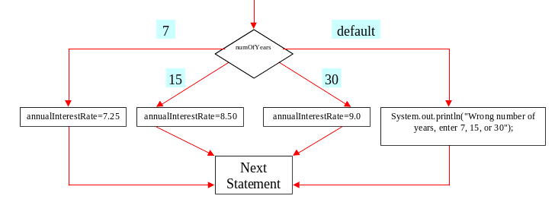
switch Statement Flow Chart

Slide 73
Repetitions
while Loops
do Loops
for Loops
Jump statements
  break and continue

Slide 74
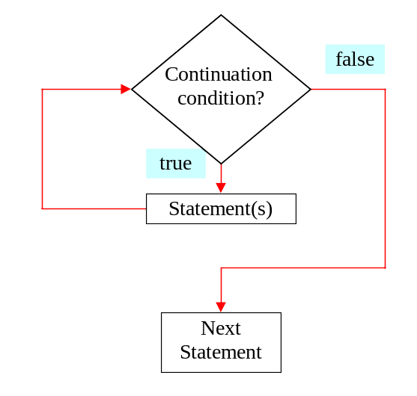
while Loop Flow Chart

Slide 75
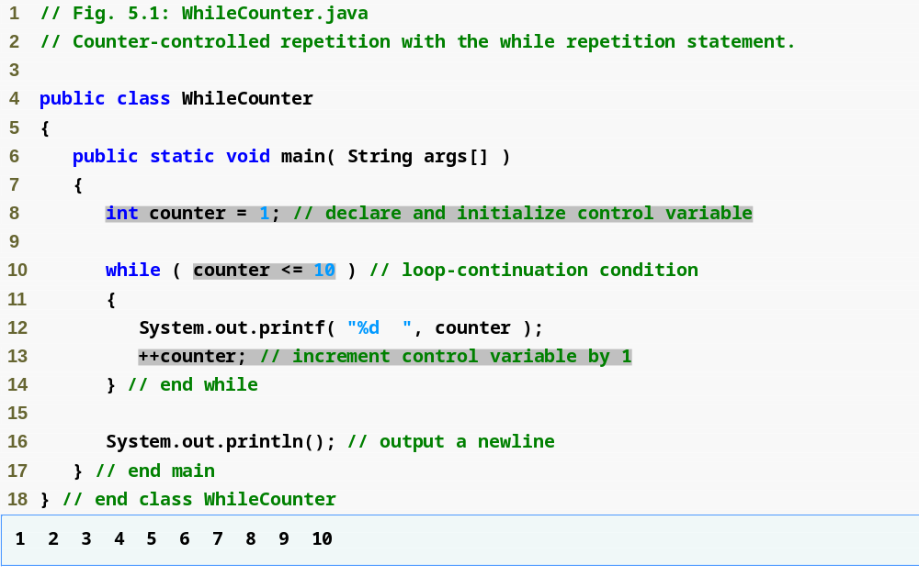
while Loops
while (continue-condition)
{
// loop-body;
}
println

Slide 76
do Loops
do
{
// Loop body;
} while (continue-condition)

Slide 77
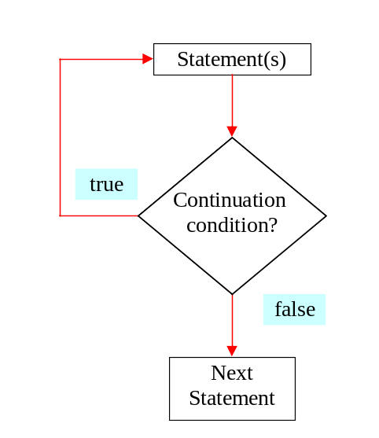
do Loop Flow Chart

Slide 78
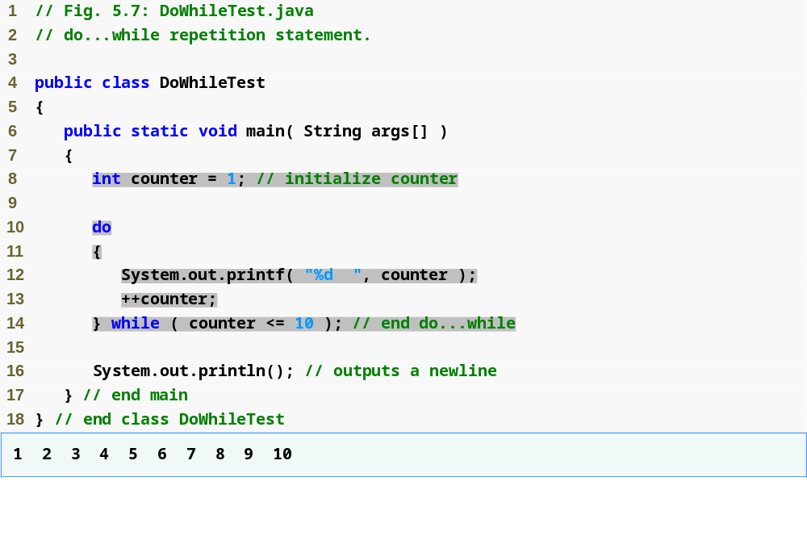
Declares and initializes control variable counter
Variable counter’s value is displayed before testing counter’s final value
println

Slide 79
for Loops
for (control-variable-initializer;
continue-condition; adjustment-statement)
{
//loop body;
}
int i = 0;
while (i < 100)
{
System.out.println("Welcome to Java! ” + i);
i++;
}
Example:
int i;
for (i = 0; i<100; i++)
{
System.out.println("Welcome to Java! ” + i);
}

Slide 80
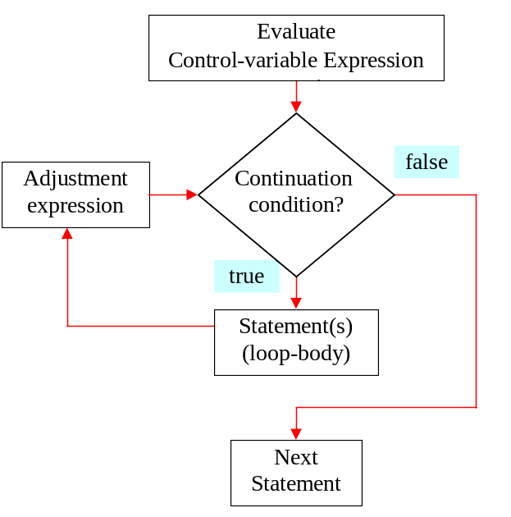
for Loop Flow Chart

Slide 81
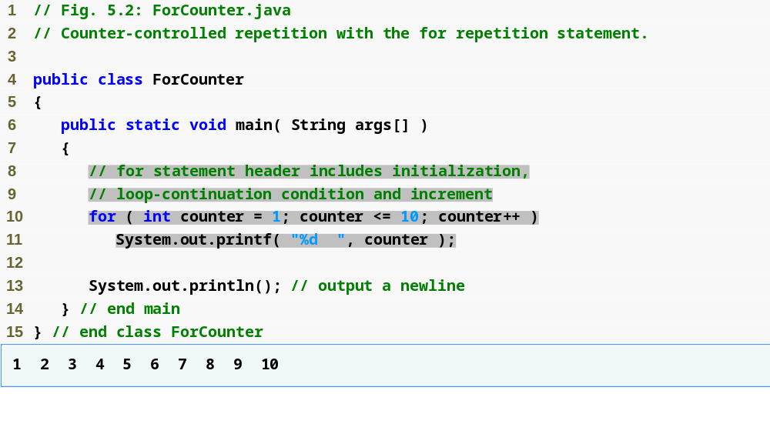
println

Slide 82
Examples Using the for Statement
Varying control variable in for statement
  Vary control variable from 1 to 100 in increments of 1
    for ( int i = 1; i <= 100; i++ )
  Vary control variable from 100 to 1 in increments of –1
    for ( int i = 100; i >= 1; i-- )
  Vary control variable from 7 to 77 in increments of 7
    for ( int i = 7; i <= 77; i += 7 )
  Vary control variable from 20 to 2 in decrements of 2
    for ( int i = 20; i >= 2; i -= 2 )
  Vary control variable over the sequence: 2, 5, 8, 11, 14, 17, 20
    for ( int i = 2; i <= 20; i += 3 )
  Vary control variable over the sequence: 99, 88, 77, 66, 55, 44, 33, 22, 11, 0
    for ( int i = 99; i >= 0; i -= 11 )

Slide 83
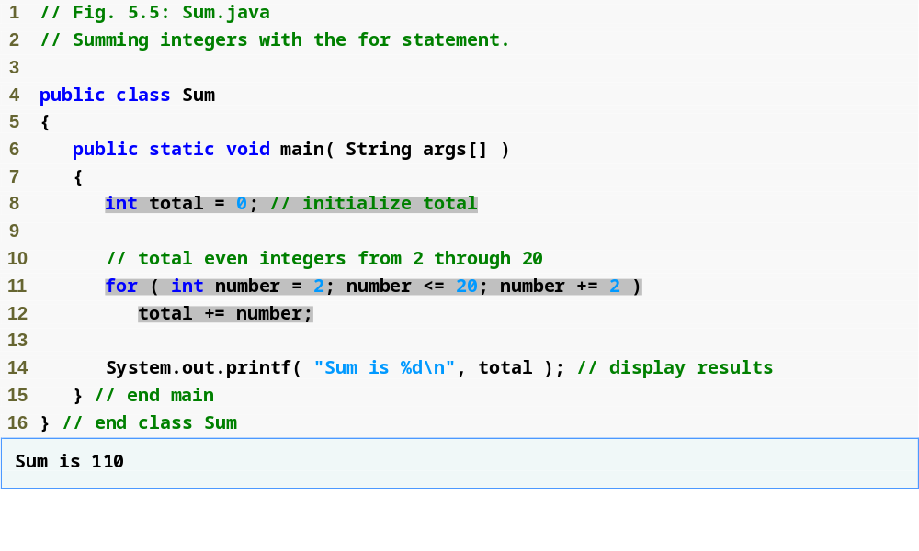
println
increment number by 2 each iteration

Slide 84
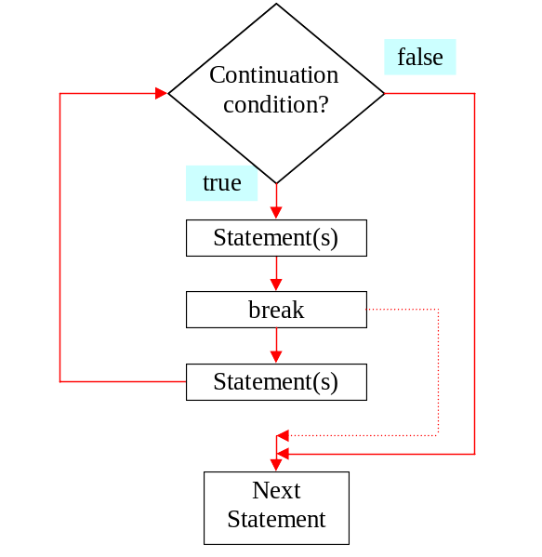
The break Keyword

Slide 85
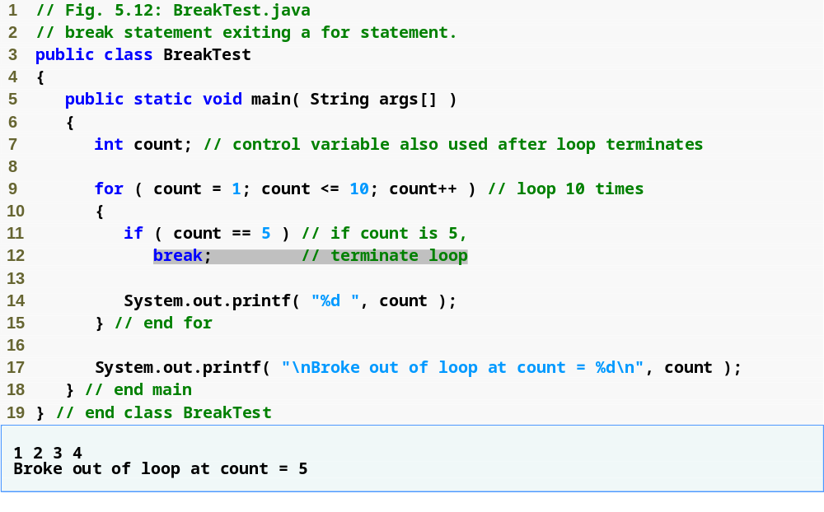
Loop 10 times
Exit for statement (break) when count equals 5
println
println

Slide 86
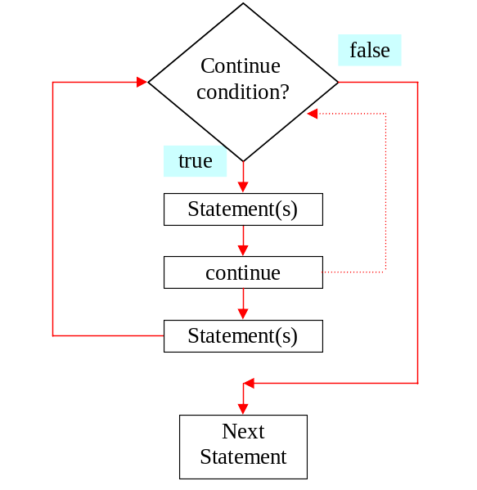
The continue Keyword

Slide 87
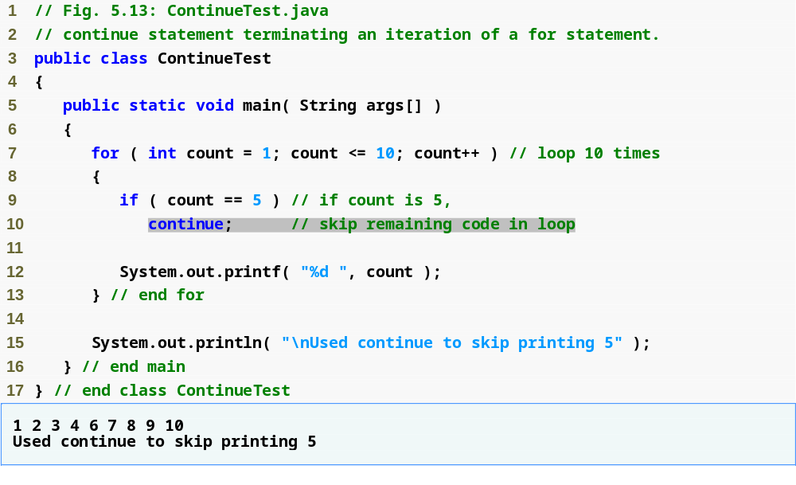
Loop 10 times
Skip line 12 and proceed to line 7 when count equals 5
println
println

Slide 88
Arrays in JAVA

Slide 89
Declaring an Array Variable
Do not have to create an array while declaring array variable
  <type> [] variable_name;
  int [] prime;
  int prime[];
Both syntaxes are equivalent
No memory allocation at this point

Slide 90
Defining an Array
Define an array as follows:
  variable_name=new <type>[N];
  primes=new int[10];
Declaring and defining in the same statement:
  int[] primes=new int[10];
In JAVA, int is of 4 bytes, total space=4*10=40 bytes

Slide 91
Graphical Representation
Index
prime
0 | 1 | 2 | 3 | 4 | 5 | 6 | 7 | 8 | 9
2 | 1 | 11 | -9 | 2 | 1 | 11 | 90 | 101 | 2
value

Slide 92
What happens if …
We define
  int[] prime=new long[20];
    MorePrimes.java:5: incompatible types
    found: long[]
    required: int[]
    int[] primes = new long[20];
    ^
The right hand side defines an array, and thus the array variable should refer to the same type of array

Slide 93
What happens if …
Valid code:
int k=7;
long[] primes = new long[k];
Invalid Code:
int k;
long[] primes =new long[k];
Compilation Output:
MorePrimes.java:6: variable k might not have been initialized
long[] primes = new long[k];
^

Slide 94
Default Initialization
When array is created, array elements are initialized
  Numeric values (int, double, etc.) to 0
  Boolean values to false
  Char values to ‘\u0000’ (unicode for blank character)

Slide 95
Accessing Array Elements
Index of an array is defined as
  Positive int, byte or short values
  Expression that results into these types
Any other types used for index will give error
  long, double, etc.
  Incase Expression results in long, then type cast to int
Indexing starts from 0 and ends at N-1
  primes[2]=0;
  int k = primes[2];
  …

Slide 96
Validating Indexes
JAVA checks whether the index values are valid at runtime
  If index is negative or greater than the size of the array then an IndexOutOfBoundException will be thrown
  Program will normally be terminated unless handled in the try {} catch {}

Slide 97
What happens if …
long[] primes = new long[20];
primes[25]=33;
….
Runtime Error:
Exception in thread “main” java.lang.ArrayIndexOutOfBoundsException: 25
at MorePrimes.main(MorePrimes.java:6)

Slide 98
Reusing Array Variables
Array variable is separate from array itself
  Like a variable can refer to different values at different points in the program
  Use array variables to access different arrays
  int[] primes=new int[10];
  ……
  primes=new int[50];
Previous array will be discarded
Cannot alter the type of array

Slide 99
Initializing Arrays
Initialize and specify size of array while declaring an array variable
  int[] primes={2,3,5,7,11,13,17}; //7 elements
You can initialize array with an existing array
  int[] even={2,4,6,8,10};
  int[] value=even;
  One array but two array variables!
  Both array variables refer to the same array
  Array can be accessed through either variable name

Slide 100
Graphical Representation
even
0 | 1 | 2 | 3 | 4
2 | 4 | 6 | 8 | 10
value

Slide 101
Demonstration
long[] primes = new long[20];
primes[0] = 2;
primes[1] = 3;
long[] primes2=primes; [memory locations also same]
System.out.println(primes2[0]);
primes2[0]=5;
System.out.println(primes[0]);

Slide 102
Output
2
5

Slide 103
Length function for integer and string
int[] myArray = new int[10];
String myString = "hello world!";
myArray.length //gives the length of the array
myString.length() //gives the length of the string

Slide 104
Array Length
Refer to array length using length
  A data member of array object
  array_variable_name.length
  for(int k=0; k<primes.length;k++)
    ….
Sample Code:
  long[] primes = new long[20];
  System.out.println(primes.length);
Output: 20

Slide 105
Change in Array Length
If number of elements in the array are changed, JAVA will automatically change the length attribute!

Slide 106
Sample Program
class MinAlgorithm
{
public static void main ( String[] args )
{
  int[] array = { -20, 19, 1, 5, -1, 27, 19, 5 } ;
  int min=array[0]; // initialize the current minimum
  for ( int index=0; index < array.length; index++ )
  if ( array[ index ] < min )
  min = array[ index ] ;
  System.out.println("The minimum of this array is: " + min );
}
}
*Program taken from: http://chortle.ccsu.edu/CS151/Notes/chap47/ch47_10.html

Slide 107
Arrays of Arrays
Two-Dimensional arrays
  float[][] temperature=new float[10][365];
  10 arrays each having 365 elements
  First index: specifies array (row)
  Second Index: specifies element in that array (column)
  In JAVA float is 4 bytes, total Size=4*10*365=14,600 bytes

Slide 108
Graphical Representation
Sample[0]
0 | 1 | 2 | 3 | 4 | 5 | 6 | 7 | 8 | 9
Sample[1]
0 | 1 | 2 | 3 | 4 | 5 | 6 | 7 | 8 | 9
Sample[2]
0 | 1 | 2 | 3 | 4 | 5 | 6 | 7 | 8 | 9

Slide 109
Initializing Array of Arrays
int[][] array2D = { {99, 42, 74, 83, 100}, {90, 91, 72, 88, 95}, {88, 61, 74, 89, 96}, {61, 89, 82, 98, 93}, {93, 73, 75, 78, 99}, {50, 65, 92, 87, 94}, {43, 98, 78, 56, 99} };
//5 arrays with 5 elements each

Slide 110
Arrays of Arrays of Varying Length
All arrays do not have to be of the same length
  float[][] samples={{0,0},{0,0}};//Intialization or dynamic intialization is must
  float[][] samples=new int [2][3];//can miss column size but row size compulsory
  samples=new float[6][];//defines # of arrays
  samples[2]=new float[6];
  samples[5]=new float[101];//Immediately define outer array size if not null pointer exception will come
Not required to define all arrays

Slide 111
Initializing Varying Size Arrays
int[][] uneven = { { 1, 9, 4 }, { 0, 2}, { 0, 1, 2, 3, 4 } };
//Three arrays
//First array has 3 elements
//Second array has 2 elements
//Third array has 5 elements

Slide 112
Array of Arrays Length
long[][] primes = new long[20][];
primes[2] = new long[30];
System.out.println(primes.length); //Number of arrays
System.out.println(primes[2].length);//Number of elements in the second array
OUTPUT:
20
30

Slide 113
Sample Program
class unevenExample3
{
public static void main( String[] arg )
{ // declare and construct a 2D array
int[][] uneven = { { 1, 9, 4 }, { 0, 2}, { 0, 1, 2, 3, 4 } };
// print out the array
for ( int row=0; row < uneven.length; row++ ) //changes row
{
System.out.print("Row " + row + ": ");
for ( int col=0; col < uneven[row].length; col++ ) //changes column
System.out.print( uneven[row][col] + " "); System.out.println();
}
}
}

Slide 114
Output
Row 0: 1 9 4
Row 1: 0 2
Row 2: 0 1 2 3 4

Slide 115
Multidimensional Arrays
A farmer has 10 farms of beans each in 5 countries, and each farm has 30 fields!
Three-dimensional array
  long[][][] beans=new long[5][10][30];
  //beans[country][farm][fields]

Slide 116
Varying length in Multidimensional Arrays
Same features apply to multi-dimensional arrays as those of 2 dimensional arrays
  long beans=new long[3][][];//3 countries
  beans[0]=new long[4][];//First country has 4 farms
  beans[0][4]=new long[10];
  //Each farm in first country has 10 fields
Three loops for printing/accessing the values.

Slide 117
Thank you

